Slide 1




Home
Appointment
y
TeamLost
Healthcare
Help
Contact us
Login
Make Appointment
CHAS clinic
Dental
Health Tips
Drink more water ……
Manage Appointment
Hospitals
Pharmacy
Polyclinics
Popular Links
News Feed
Health related news will be displayed here
Find Hospital
Find Pharmacy
Find Polyclinic
Make Appointment

Slide 2
Home
Appointment
y
TeamLost
Healthcare
Help
Contact us
Login
Make Appointment
CHAS clinic
Dental
Health Tips
Drink more water ……
Admin
Manage Appointment
Hospitals
Pharmacy
Polyclinics
User
Popular Links
News Feed
Health related news will be displayed here
Find Hospital
Find Pharmacy
Find Polyclinic
Make Appointment

Slide 3
Admin Login
Flow :
Login -> Admin -> Admin Login Page
Login
User Name *:
Password* :
Lee Jian Jian
490 characters remaining
Login

Slide 4

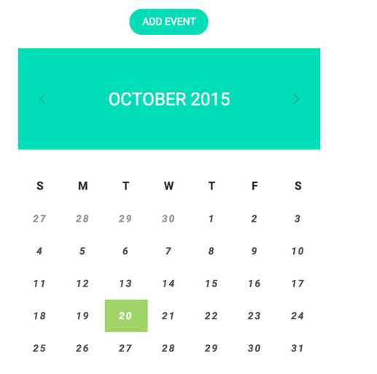


Home (Admin)
y
TeamLost
Logout
Welcome xxx,
last login 18/9/2018
Hospitals
Phrmacy
 | User Feedback
Polyclinics
Settings

Slide 5
View Feedback(Admin)
TeamLost
Home
Appointment
Healthcare
Help
Logout
Peter
User friendly website
Amy
This website is very useful
Lim Ah Kow
User friendly
Zhen Mei Li
User friendly
Siti
User friendly
1 2 3

Slide 6

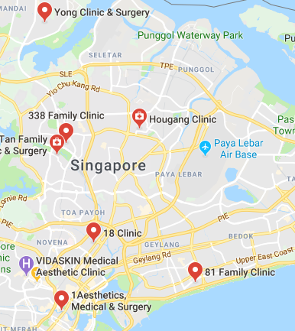
Flow :
Home -> Healthcare -> CHAS Clinic
CHAS Clinic
The current location is auto detected and will be auto filled to the “location” text box. However, if user wish to edit the current location, he/she can also manually fill in the current location.
If the location textbox is empty, the system will display all the CHAS clinic within 5 kilometres.
User can view details of the clinic by clicking the “+” sign.
User can make appointment by clicking the “Book” button.
Location…
Yong Clinic & Surgery
Address:
HDB Yishun #01-06, 632 Yishun Street 61 (S)760632, Singapore 760632
Opening Hour:
8:30AM – 9:00PM
Map
81 Clinic
Hougang Clinic
338 Family Clinic
Book

Slide 7
Book Appointment Page (CHAS Clinic)
Flow :
Home -> Healthcare -> CHAS clinic-> Book
Book Appointment
After user enter location and click book, system will direct user to this page.
The location and address of selected CHAS clinic will be retrieved and display automatically in the textbox.
The location and address will not be editable.
CHAS Clinic
Location :
Address:
Personal Particulars
NRIC/ FIN *:
Date Of Birth (yy/mm/dd)*:
Mobile Number* :
Appointment Details
Date* :
Time *:
Yong Clinic & Surgery
HDB Yishun #01-06, 632 Yishun Street 61 (S)760632, Singapore 760632
Book
Back

Slide 8
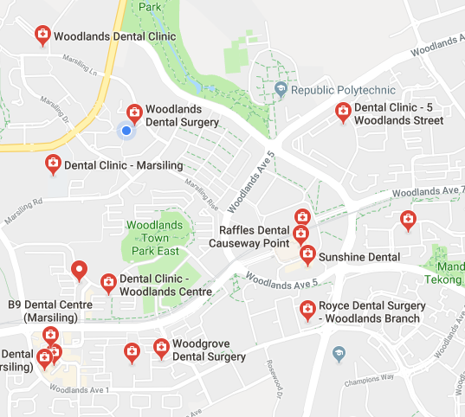
Flow :
Home -> Healthcare -> Dental Clinic
Dental Clinic
The current location is auto detected and will be auto filled to the “location” text box. However, if user wish to edit the current location, he/she can also manually fill in the current location.
If the location textbox is empty, the system will display all the dental clinic within 5 kilometres.
User can view details of the dental clinic by clicking the “+” sign.
User can make appointment by clicking the “Book” button.
Location…
Woodlands Dental Clinic
Address:
211 Marsiling Crescent, Singapore 730211
Opening Hour:
9:30AM – 7:30PM
Map
89 Dental Clinic
Dental Clinic – Marsiling
Sunshine Dental
Book

Slide 9
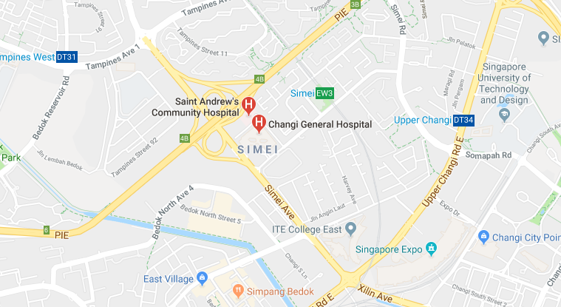
Flow :
Home -> Healthcare -> Hospital
Hospital
The current location is auto detected and will be auto filled to the “location” text box. However, if user wish to edit the current location, he/she can also manually fill in the current location.
If the location textbox is empty, the system will display all the hospitals within 5 kilometres.
User can view details of the hospital by clicking the “+” sign.
User can make appointment by clicking the “Book” button.
Location…
Changi General Hospital
Address:
2 Simei Street 3, Singapore 529889
Opening Hour:
24 hours
Map
Khoo Teck Puat Hospital
Mount Elizabeth Hospital
Singapore General Hospital
Book

Slide 10
Book Appointment Page (Dental Clinic)
Flow :
Home -> Healthcare -> dental clinic-> Book
Book Appointment
After user enter location and click book, system will direct user to this page.
The location and address of selected dental clinic will be retrieved and display automatically in the textbox.
Dental Clinic
Location :
Address:
Personal Particulars
NRIC/ FIN *:
Date Of Birth (yy/mm/dd)*:
Mobile Number* :
Appointment Details
Date* :
Time *:
Services* :
Preferred dentist (Optional):
Woodlands Dental Clinic
211 Marsiling Crescent, Singapore 730211
Book
Back

Slide 11
Book Appointment Page (Hospital)
Flow :
Home -> Healthcare -> hospital > Book
Book Appointment
Hospital
Location :
Address:
Personal Particulars
NRIC/ FIN *:
Date Of Birth (dd/mm/yy)*:
Mobile Number* :
Appointment Details
Date* :
Time *:
Department* :
Condition (Optional):
Changi General Hospital
After user enter location and click book, system will direct user to this page.
The location and address of selected hospital will be retrieved and display automatically in the textbox.
2 Simei Street 3, Singapore 529889
Book
Back

Slide 12
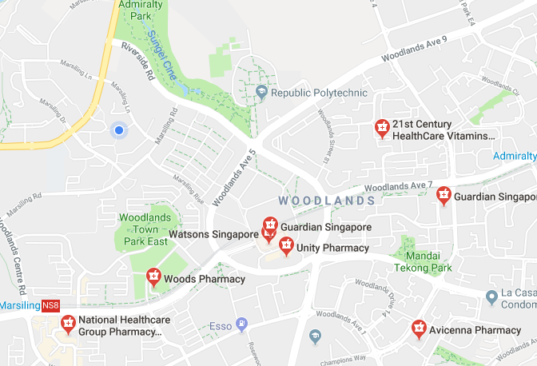
Flow :
Home -> Healthcare -> Pharmacy
Pharmacy
The current location is auto detected and will be auto filled to the “location” text box. However, if user wish to edit the current location, he/she can also manually fill in the current location.
If the location textbox is empty, the system will display all the pharmacy within 5 kilometres.
User can view details of the pharmacy by clicking the “+” sign.
Location…
National Healthcare Group Pharmacy - woodlands
Address:
10 Woodlands Street 31, Singapore 738579
Opening Hour:
8:30AM-4:30PM
Map
Woods Pharmacy
Avicenna Pharmacy
Unity Pharmacy

Slide 13
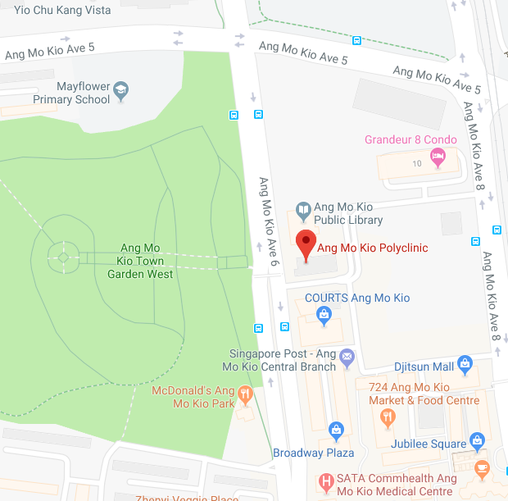
Flow :
Home -> Healthcare -> Polyclinic
Polyclinic
The current location is auto detected and will be auto filled to the “location” text box. However, if user wish to edit the current location, he/she can also manually fill in the current location.
If the location textbox is empty, the system will display all the polyclinics within 5 kilometres.
User can view details of the polyclinic by clicking the “+” sign.
User can make appointment by clicking the “Book” button.
Location…
AMK Polyclinic
Address:
Ang Mo Kio Central 2, Ang Mo Kio Polyclinic, Singapore
Opening Hour:
8:30AM-4:30PM
Map
Bishan Polyclinic
CCK Polyclinic
Dover Polyclinic
Book

Slide 14
Book Appointment Page (Polyclinic)
Flow :
Home -> Healthcare -> Polyclinic > Book
Book Appointment
After user enter location and click book, system will direct user to this page.
The location and address of selected polyclinic will be retrieved and display automatically in the textbox.
Polyclinic
Location :
Address:
Personal Particulars
NRIC/ FIN *:
Date Of Birth (yy/mm/dd)*:
Mobile Number* :
Appointment Details
Date* :
Time *:
Department* :
Condition (Optional):
AMK Polyclinic
Ang Mo Kio Central 2, Ang Mo Kio Polyclinic, Singapore
Book
Back

Slide 15
Appointment (CHAS Clinic)
Flow :
Home -> Appointment -> Make appointment -> CHAS Clinic
The current location is auto detected and will be auto filled to the “location” text box. However, if user wish to edit the current location, he/she can also manually fill in the current location.
User choose different healthcare premises to make appointment.
If the location textbox is empty, the system will display all the CHAS clinic within 5 kilometres.
User can view details of the clinic by clicking the “+” sign.
User can make appointment by clicking the “Book” button.
Location…
Yong Clinic & Surgery
Address:
HDB Yishun #01-06, 632 Yishun Street 61 (S)760632, Singapore 760632
Opening Hour:
8:30AM – 9:00PM
CHAS Clinic
Dental Clinic
Hospital
Pharmacy
Polyclinic
Map
81 Clinic
Hougang Clinic
338 Family Clinic
Book

Slide 16
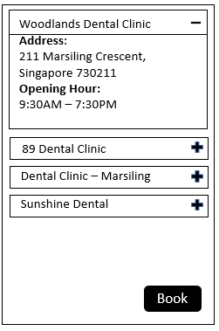
Appointment (Dental Clinic)
Flow :
Home -> Appointment -> Make appointment ->Dental Clinic
The current location is auto detected and will be auto filled to the “location” text box. However, if user wish to edit the current location, he/she can also manually fill in the current location.
User choose different healthcare premises to make appointment.
If the location textbox is empty, the system will display all the dental clinic within 5 kilometres.
User can view details of the clinic by clicking the “+” sign.
User can make appointment by clicking the “Book” button.
Location…
CHAS Clinic
Dental Clinic
Hospital
Pharmacy
Polyclinic
Map

Slide 17
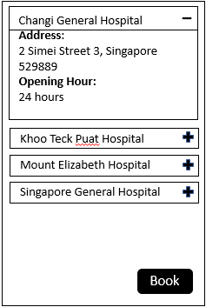
Appointment (Hospital)
Flow :
Home -> Appointment -> Make appointment ->Hospital
The current location is auto detected and will be auto filled to the “location” text box. However, if user wish to edit the current location, he/she can also manually fill in the current location.
User choose different healthcare premises to make appointment.
If the location textbox is empty, the system will display all the hospital within 5 kilometres.
User can view details of the clinic by clicking the “+” sign.
User can make appointment by clicking the “Book” button.
Location…
CHAS Clinic
Dental Clinic
Hospital
Pharmacy
Polyclinic
Map

Slide 18
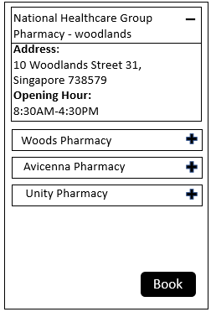
Appointment (Pharmacy)
Flow :
Home -> Appointment -> Make appointment ->Pharmacy
The current location is auto detected and will be auto filled to the “location” text box. However, if user wish to edit the current location, he/she can also manually fill in the current location.
User choose different healthcare premises to make appointment.
If the location textbox is empty, the system will display all the Pharmacy within 5 kilometres.
User can view details of the clinic by clicking the “+” sign.
Location…
CHAS Clinic
Dental Clinic
Hospital
Pharmacy
Polyclinic
Map

Slide 19
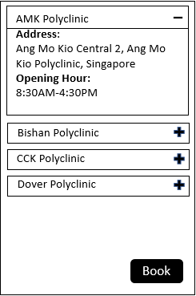
Appointment (Polyclinic)
Flow :
Home -> Appointment -> Make appointment ->Polyclinic
The current location is auto detected and will be auto filled to the “location” text box. However, if user wish to edit the current location, he/she can also manually fill in the current location.
User choose different healthcare premises to make appointment.
If the location textbox is empty, the system will display all the Polyclinic within 5 kilometres.
User can view details of the clinic by clicking the “+” sign.
User can make appointment by clicking the “Book” button.
Location…
CHAS Clinic
Dental Clinic
Hospital
Pharmacy
Polyclinic
Map

Slide 20

Manage Appointment Page
Flow :
Home -> Appointment -> Manage appointment
1. After user clicks “Manage”, there will be a pop out requesting user to enter One-time password that is sent to his/her mobile number.
2. In the event when the user entered the wrong OTP. An error message will be displayed.
3. The user can re-enter the OTP again. Or the user can request for another OTP to be sent.
Manage Appointment
NRIC/ FIN *:
Date Of Birth (dd/mm/yy)*:
Mobile Number*:
S9012312Z
12/12/90
Resend OTP
OTP :
123456
Manage
Back
Confirm
Cancel

Slide 21
Manage Appointment Page
Flow :
Home -> Appointment -> Manage appointment
1. After user clicks “Manage”, there will be a pop out requesting user to enter One-time password that is sent to his/her mobile number.
2. In the event when the user entered the wrong OTP. An error message will be displayed.
3. The user can re-enter the OTP again. Or the user can request for another OTP to be sent.
Manage Appointment
NRIC/ FIN *:
Date Of Birth (dd/mm/yy)*:
Mobile Number*:
S9012312Z
12/12/90
Incorrect OTP ! Resend OTP
OTP :
Manage
Back
Confirm
Cancel

Slide 22
Manage Appointment Page (con’t)
Flow :
Home -> Appointment -> Manage appointment
Manage Appointment
System display existing appointment.
NRIC/ FIN *:
Date Of Birth (yy/mm/dd)*:
Mobile Number*:
Your Appointment
S1234567C
90/12/01
99001122
Healthcare premises | Date | Time | Action
AMK Polyclinic | 12/11/19 | 10:00AM
Edit
Delete

Slide 23
Edit Appointment Page
Flow :
Home -> Healthcare -> Polyclinic > Manage Appointment
Edit Appointment
Polyclinic
Location :
Address:
Personal Particulars
NRIC/ FIN *:
Date Of Birth (yy/mm/dd)*:
Mobile Number* :
Appointment Details
Date* :
Time *:
Department* :
Condition (Optional):
After user select edit function, the system will direct user to edit appointment page.
The system will retrieve user’s personal and appointment details.
User is required to enter new appointment details.
AMK Polyclinic
Ang Mo Kio Central 2, Ang Mo Kio Polyclinic, Singapore
S1234567C
90/12/01
99001122
Submit
Back

Slide 24
Delete Appointment Page
Flow :
Home -> Appointment -> Manage appointment
Manage Appointment
NRIC/ FIN *:
Date Of Birth (yy/mm/dd)*:
Mobile Number*:
Your Appointment
S1234567C
90/12/01
99001122
Are you sure you want to delete?
Yes
No
Healthcare premises | Date | Time | Action
AMK Polyclinic | 12/11/19 | 10:00AM
Edit
Delete

Slide 25
Help
Flow :
Home ->Help
Help Message / FAQ
How to Book an appointment
Step 1: Go To Appointment
Step 2: Book Appointment Duh
Search for more...
- Appointment
How to Book an appointment
Location
Foreigners

Slide 26
Help (Search FAQ)
Flow :
Home ->Help
Help Message / FAQ
How to Book an appointment
Step 1: Go To Appointment
Step 2: Book Appointment Duh
How to
- Appointment
How to Book an appointment
Location
How to search by hospital

Slide 27
Contact us
Flow :
Home -> Contact us
Feedback
Name *:
Mobile Number* :
Message*:
Lee Jian Jian
Your Number is required
Me Dunno How to use diz systam. teech me piz.
490 characters remaining
Submit

Slide 28

Footer
Appointment
Make Appointment
Manage Appointment
Healthcare
CHAS clinic
Dental
Hospitals
Pharmacy
Polyclinics
Suggestion ?
Feedback
Need help ?
FAQ
Community
Submit
Copyright © 2018 TeamLost

